Slide 1

Grocers Store

Slide 2

Grocers Store
Online shopping is something that most of us take for granted these days. We enjoy the convenience and other benefits of shopping online.
When we remember that, we realize that we’re still in the early stages of online shopping.
We’re still learning what works, what doesn’t and how we can improve this great shopping option so that it’s even better in the future than it is today.

Slide 3
Goals
User Module
Admin Module
Employee Module
Software's and technologies used
Eclipse IDE
VS Code
Java
Spring Boot
Angular
MySQL

Slide 4
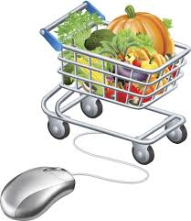
Admin Services
Admin can able to add employees, delete employees, view requests
Admin can able to add products, update products, delete products as per the request from employees.
Also admin can able to view the daily, weekly, monthly and yearly reports.

Slide 5

Customer services
User can able to select items, delete items, view items and checkout operations part of the cart
User also can able to check the order status, funds and able to edit his profile.
Usual customers
busy young professionals
value saving 50 mins trip and queue
65% of customers
physically unfit (eg: seniors, pregnant mothers, injured people, etc)
20% of customer

Slide 6
Employee Services
Employee can able to send request to admin about the stock update.
Employee can able to update order status.
Employee can also able to unlock users and edit profile.

Slide 7
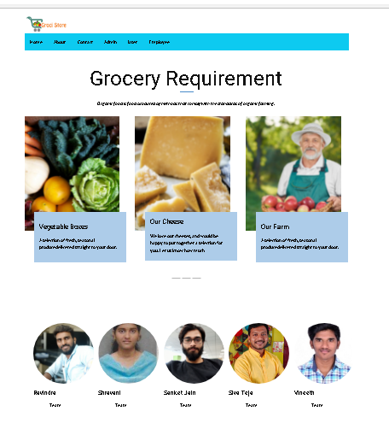
Home Page

Slide 8
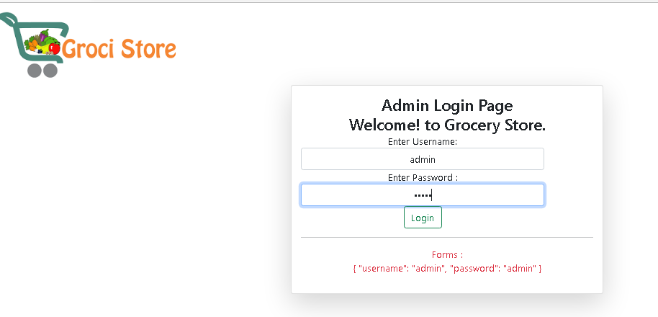
Admin Login

Slide 9
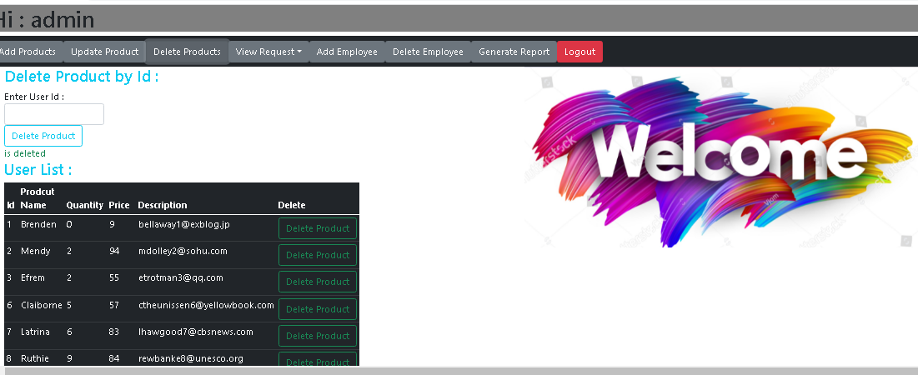
Admin Home page

Slide 10
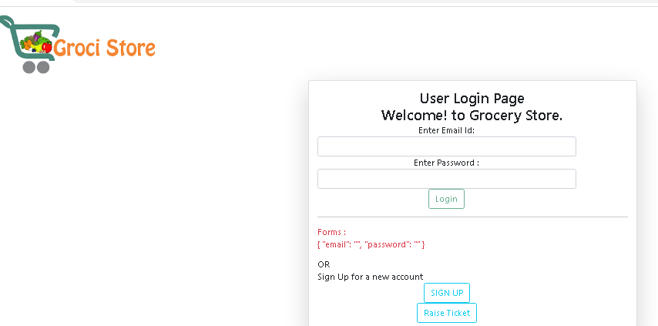
User Login

Slide 11
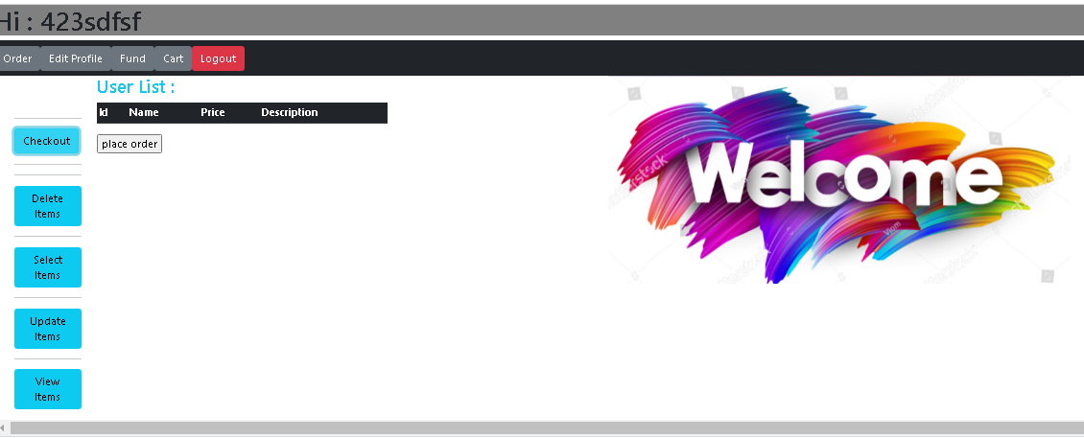
User Home page

Slide 12
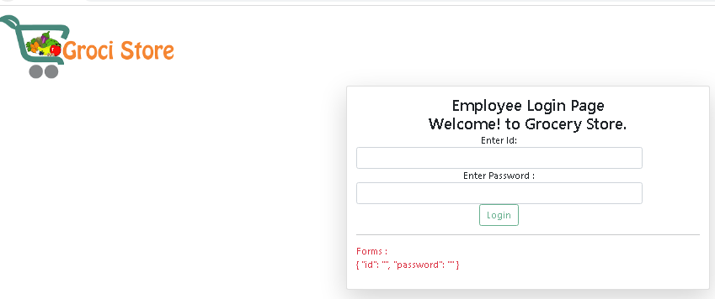
Employee Login

Slide 13
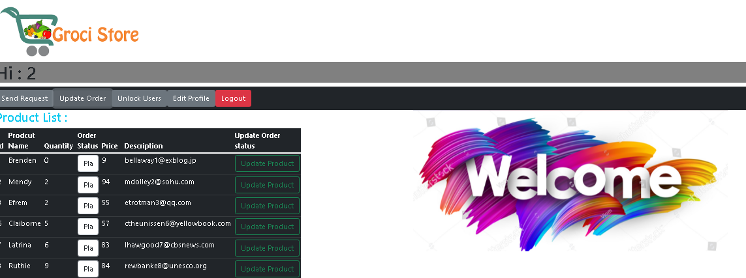
Employee Home page

Slide 14


